Slide 1

Build a Personalized Online Course Recommender System with Machine Learning
Aaron Niecestro
IBM Machine Learning Professional Certificate
November 10, 2026

Slide 2

Outline
Introduction and Background
Exploratory Data Analysis
Content-based Recommender System using Unsupervised Learning
Collaborative-filtering based Recommender System using Supervised learning
Conclusion
Appendix

Slide 3
Project Background & Context
Background
Online learning platforms offer hundreds of courses across multiple domains.
Learners often struggle to identify courses that match their interests and learning goals.
Recommendation systems help personalize learning experiences by suggesting relevant courses based on historical interactions.
Context
Dataset consists of:
233,306 course ratings
Multiple recommendation approaches were evaluated:
Content-Based Filtering
Clustering-Based Filtering
KNN Collaborative Filtering
Matrix Factorization (NMF)
Neural Collaborative Filtering
Embedding-Based Regression
Classification Models
33,901 users
307 content-based courses
126 courses used in collaborative-filtering models
Notes:
Online learning platforms offer a large number of courses, making it difficult for learners to identify content that matches their interests and learning goals.
Recommendation systems help improve the learning experience by providing personalized course suggestions based on user behavior and course characteristics.
The dataset used in this project contains 233,306 course ratings from 33,901 users and supports multiple recommendation approaches.
Both content-based and collaborative-filtering techniques were explored, including user profile recommendations, course similarity models, clustering methods, KNN, NMF, and neural network approaches.
The objective of this project was to compare these approaches and identify the most effective method for generating personalized course recommendations.

Slide 4
Research Questions & Hypotheses
Research Questions
Which recommendation approach produces the most effective course recommendations?
Hypotheses
1: Content-based recommenders can generate relevant personalized recommendations.
Can content-based filtering generate meaningful recommendations from course features and user interests?
Can clustering users improve recommendation quality?
Which collaborative-filtering model achieves the lowest RMSE?
How does dataset sparsity affect recommendation performance?
2: Users with similar learning interests can be grouped using clustering techniques.
3: Recommendation performance varies across algorithms and hyperparameter settings.
4: Neural network embeddings can learn meaningful latent user and course representations.
5: High sparsity negatively impacts matrix factorization approaches such as NMF.
6: Neural collaborative filtering will achieve the best overall prediction accuracy.
Notes:
This project investigates multiple recommendation techniques to determine which approach produces the most effective personalized course recommendations.
The analysis evaluates both content-based and collaborative-filtering methods, including user profile models, course similarity models, clustering approaches, KNN, NMF, and neural network recommenders.
Key research questions focus on recommendation effectiveness, the usefulness of content-based filtering, the impact of user clustering, collaborative-filtering performance, and the effects of dataset sparsity
Several hypotheses were proposed, including that content-based methods can generate meaningful recommendations, clustering can identify groups of similar learners, and neural network embeddings can capture latent user and course preferences.
The project also hypothesizes that dataset sparsity negatively affects matrix factorization performance and that neural collaborative filtering will provide the most accurate rating predictions.
The following sections evaluate these hypotheses through exploratory analysis, recommender system development, and model performance comparisons.

Slide 5
Exploratory Data Analysis

Slide 6
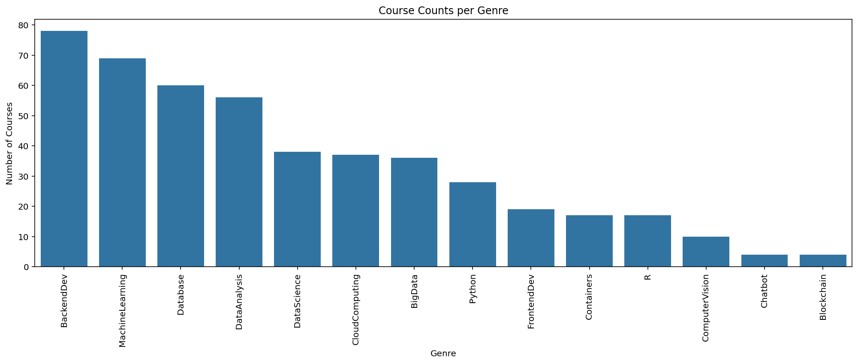
Course counts per genre
Key Findings
Backend Development contains the most courses (78).
Machine Learning is the second largest genre (69).
Database (60) and Data Analysis (56) are also highly represented.
Chatbot (4) and Blockchain (4) contain the fewest courses.
Insight
The course catalog spans 14 genres, with the strongest representation in software development, data science, and machine learning. This provides a diverse foundation for building personalized recommendation systems.
Notes:
The dataset contains courses across 14 different genres.
Backend Development has the highest number of courses, followed by Machine Learning, Database, and Data Analysis.
Data Science, Cloud Computing, and Big Data are also well represented.
Specialized areas such as Chatbot and Blockchain contain relatively few courses.
The broad distribution of topics supports the development of recommendation systems capable of serving learners with diverse interests.

Slide 7
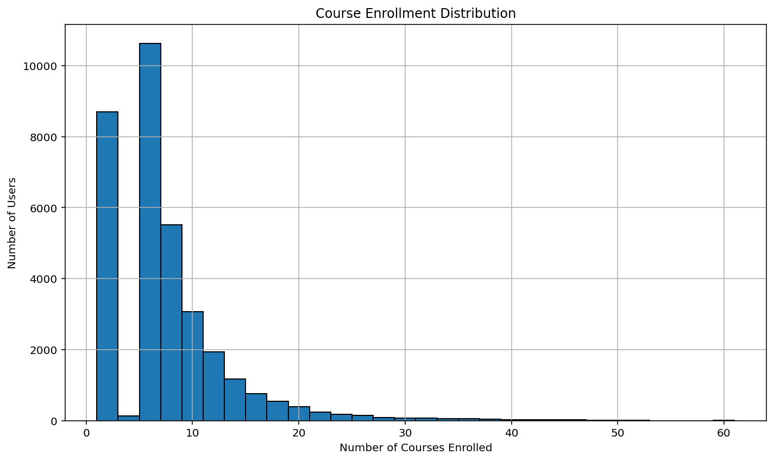
Course enrollment distribution
Key Findings
Most users enrolled in fewer than 10 courses
Average enrollments per user: 6.9
Median enrollments per user: 6
Maximum enrollments observed: 61
Enrollment distribution is right-skewed.
Insight
Most learners enroll in only a few courses, while a small number of highly active learners enroll in many courses. This variation in behavior highlights the need for personalized course recommendations.
Notes:
The histogram shows the distribution of course enrollments across 33,901 users.
Most users enrolled in a relatively small number of courses, with the highest concentration occurring between 5 and 10 enrollments.
The average user enrolled in 6.88 courses, while the median user enrolled in 6 courses.
A small number of highly active users enrolled in many courses, with the maximum reaching 61 enrollments.
The long right tail indicates that learner engagement varies considerably across users, supporting the need for personalized course recommendations.

Slide 8
20 most popular courses
Rank | Course Title | Enrollments
1 | Python for Data Science | 14,936
2 | Introduction to Data Science | 14,477
3 | Big Data 101 | 13,291
4 | Hadoop 101 | 10,599
5 | Data Analysis with Python | 8,303
6 | Data Science Methodology | 7,719
7 | Machine Learning with Python | 7,644
8 | Spark Fundamentals I | 7,551
9 | Data Science Hands-on with Open Source Tools | 7,199
10 | Blockchain Essentials | 6,719
11 | Data Visualization with Python | 6,709
12 | Deep Learning 101 | 6,323
13 | Build Your Own Chatbot | 5,512
14 | R for Data Science | 5,237
15 | Statistics 101 | 5,015
16 | Introduction to Cloud | 4,983
17 | Docker Essentials: A Developer Introduction | 4,480
18 | SQL and Relational Databases 101 | 3,697
19 | MapReduce and YARN | 3,670
20 | Data Privacy Fundamentals | 3,624
Key Findings
Python for Data Science was the most popular course (14,936 enrollments).
Key Insight
Learner demand is concentrated around a relatively small number of foundational data science, analytics, and machine learning courses.
Introduction to Data Science ranked second (14,477 enrollments).
Big Data 101 ranked third (13,291 enrollments).
Data science, machine learning, and big data courses dominated the rankings.
The Top 20 courses accounted for approximately 63.3% of total enrollments.
Notes:
Python for Data Science was the most enrolled course with 14,936 enrollments.
Introduction to Data Science and Big Data 101 were the next most popular courses.
Most highly enrolled courses focused on data science, analytics, machine learning, and big data topics.
The Top 20 courses represented approximately 63.3% of all enrollments, indicating that learner demand was concentrated among a relatively small group of courses.
These popularity patterns can serve as valuable signals when generating course recommendations.

Slide 9
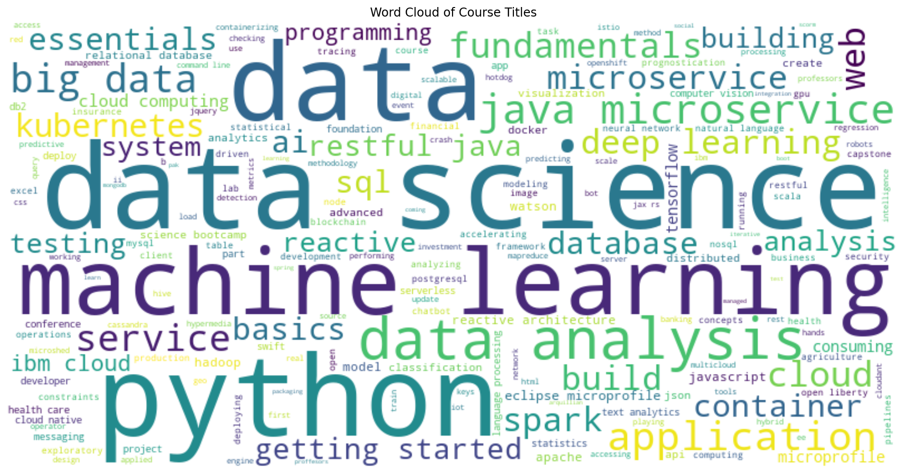
Word cloud of course titles
Key Findings
"Data", "Science", and "Python" are the most prominent words.
Machine Learning, Cloud, SQL, and Database are also frequently represented.
Most course titles focus on data science, analytics, AI, and software development.
The catalog is strongly aligned with current technology and data-driven skills.
Key Insight
The course catalog is heavily concentrated in data science, machine learning, analytics, and cloud computing topics.
Notes:
The word cloud highlights the most frequently occurring terms in course titles.
Data, Science, Python, and Machine Learning appear most prominently, indicating strong coverage of these subject areas.
Additional terms such as Cloud, Database, SQL, Spark, and Deep Learning further emphasize the platform's focus on data-centric technologies.
The visualization confirms that the dataset is largely composed of courses related to data science, artificial intelligence, and software development.
These topic concentrations help explain enrollment trends observed in the previous analysis.

Slide 10
Content-based Recommender System using Unsupervised Learning
Cluster2
Cluster1

Slide 11
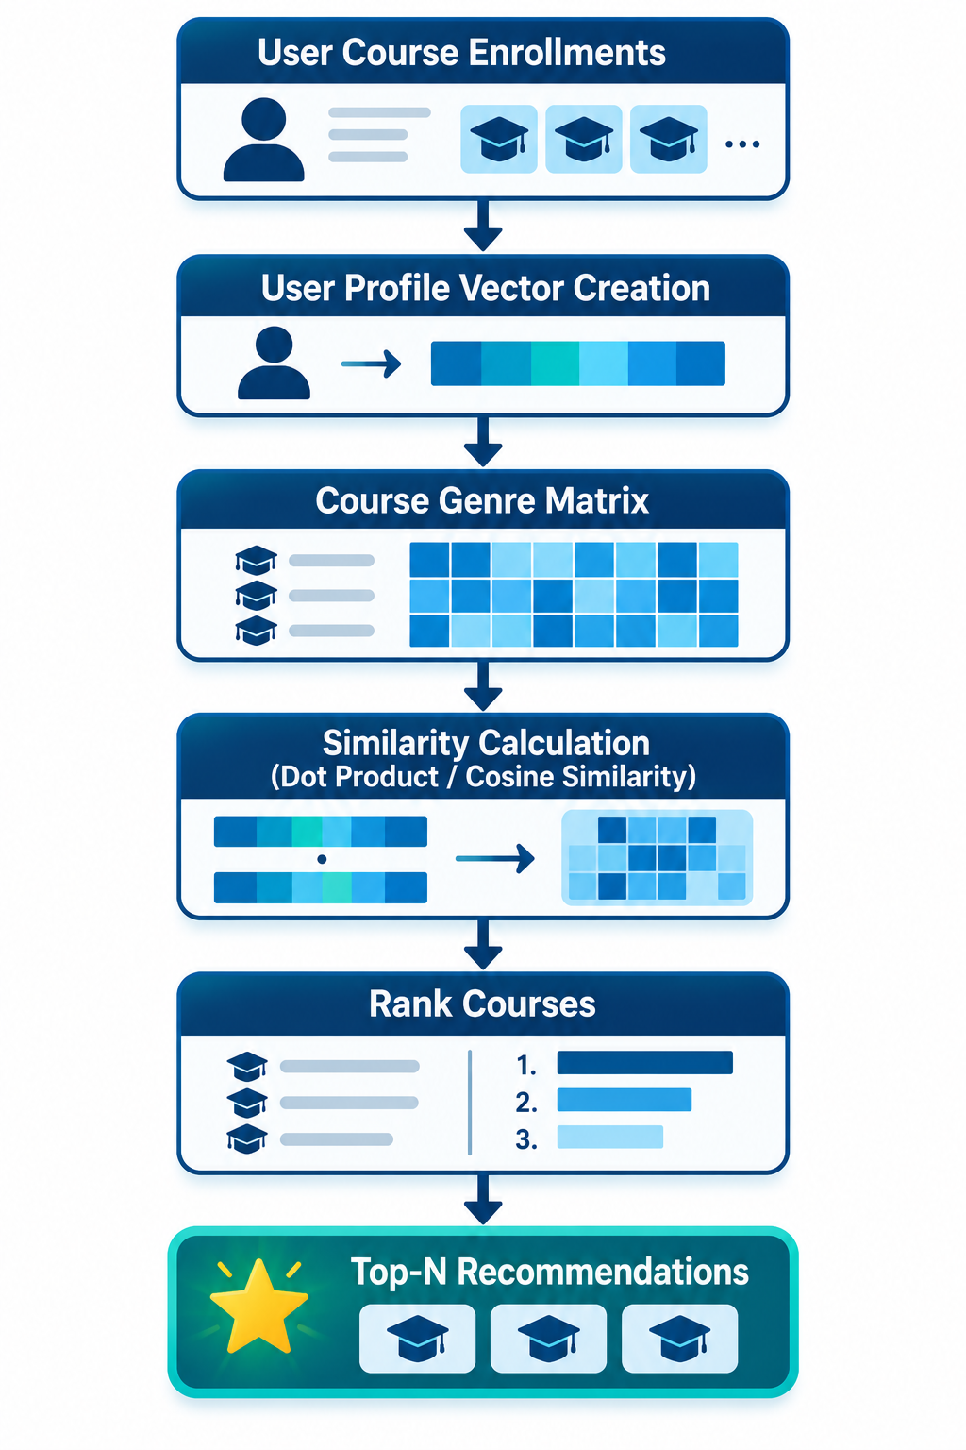
Flowchart of content-based recommender system using user profile and course genres
Key Steps
Collect user enrollment history
Build user profile from enrolled course genres
Represent courses using genre vectors
Calculate similarity scores
Rank unseen courses
Recommend highest-ranked courses
Key Insight
Recommendations are generated using course content and user interests rather than learner-to-learner similarities.
Generate recommendation scores using dot product similarity
Notes:
User enrollment history was used to build a genre-based profile for each learner.
Course genre information was transformed into content feature vectors.
Similarity scores were calculated between user profiles and available courses.
Previously completed courses were excluded from recommendations.
Unseen courses were ranked by similarity score and recommended to the user.
This approach relies on course content rather than interactions from other users.

Slide 12
Evaluation results of user profile-based recommender system
Hyperparameter Settings
Recommendation Score Threshold = 10.0
User Profile Vector = Course Genre Preferences
Recommendation Method = Content-Based Filtering
Recommendation Statistics
Users Evaluated: 33,901
Total Recommendations: 1,500,424
Average Recommendations per User: 60.82
Key Finding
Each user received approximately 61 unseen course recommendations on average.
Average Recommendation Score: 19.12
Course Title | Recommendation Count
Text Analytics at Scale | 17,390
Applied Machine Learning in Python | 15,656
Introduction to Data Science in Python | 15,656
Data Science in Insurance | 15,644
Accelerating Deep Learning with GPU | 15,603
SQL for Data Science | 15,062
SQL for Data Science Capstone Project | 15,062
Database Operations in Cloudant | 14,689
Analyzing Big Data with SQL | 14,464
Foundations for Big Data Analysis with SQL | 14,464
Notes:
Recommendations were generated using user genre preferences and content-based filtering.
A recommendation score threshold of 10.0 was used to identify relevant courses.
The model evaluated 33,901 users and generated more than 1.5 million recommendations.
On average, each learner received approximately 61 unseen course recommendations.
The most frequently recommended courses were primarily related to data science, machine learning, and SQL analytics.
These results demonstrate the ability of user-profile filtering to generate large numbers of personalized recommendations.

Slide 13
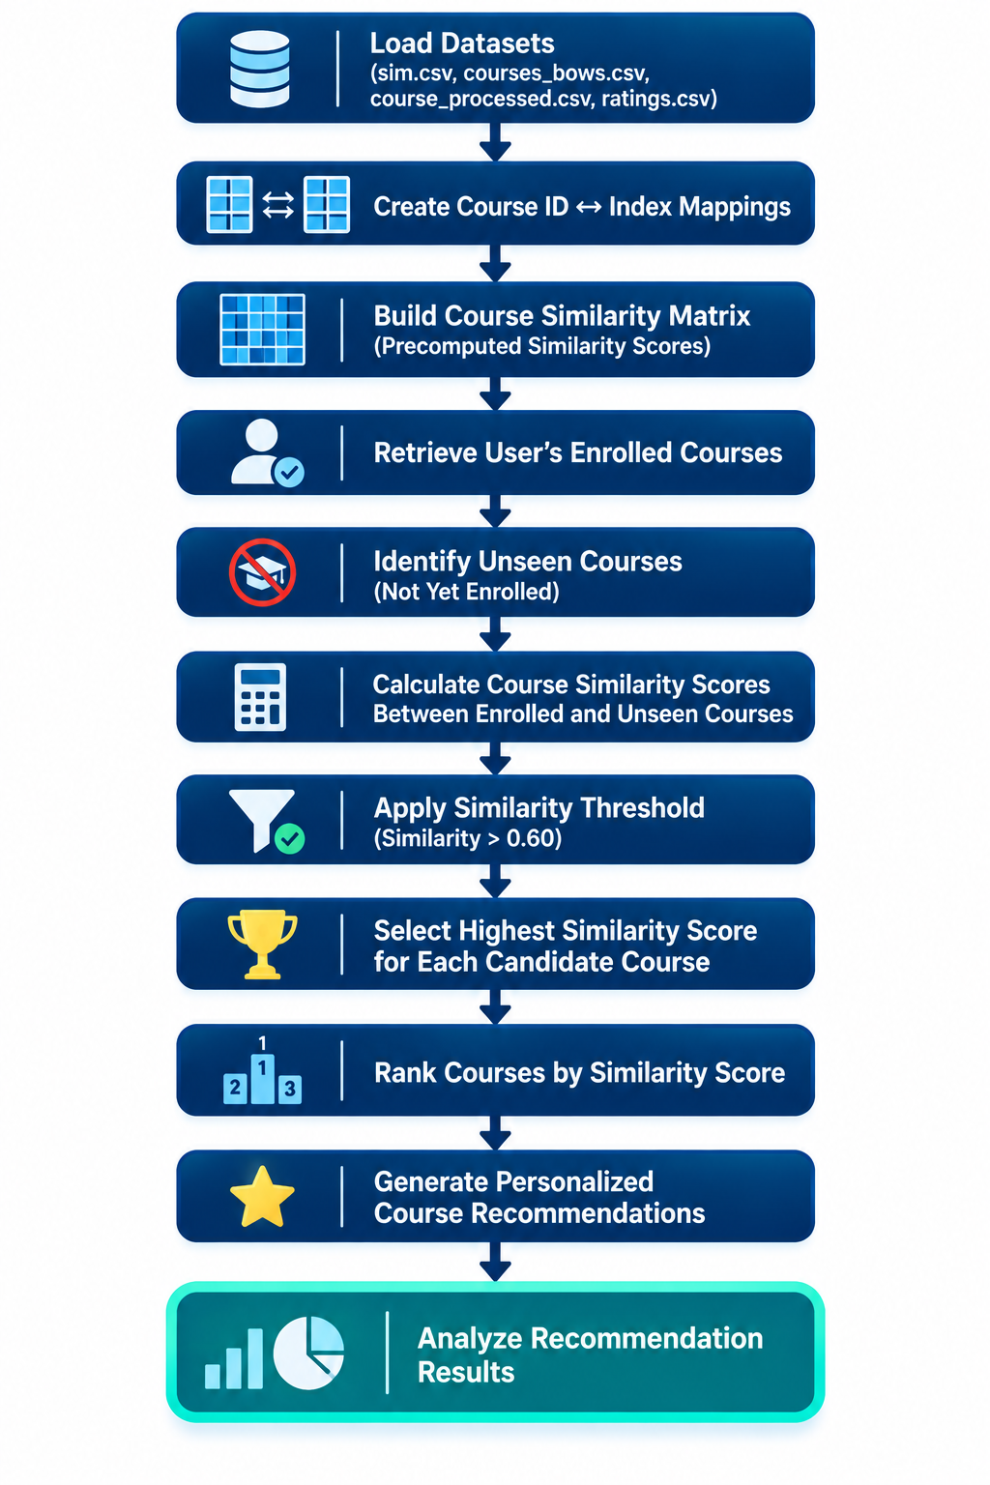
Flowchart of content-based recommender system using course similarity
Method
Bag-of-Words Feature Extraction
Hyperparameter
Similarity Threshold = 0.60
Key Insight
Recommendations are generated by identifying courses with content similar to those previously completed by a learner.
Course Similarity Matrix (307 × 307)
Content-Based Filtering
Notes:
The recommender system uses a precomputed course similarity matrix derived from Bag-of-Words representations of course content.
For each user, enrolled courses are identified and compared with unseen courses.
Similarity scores are retrieved from the course similarity matrix.
Courses with similarity scores greater than 0.60 are retained as recommendation candidates.
The highest similarity score is kept for each candidate course, and recommendations are ranked by similarity strength.
The final output is a personalized list of recommended courses together with recommendation analytics.

Slide 14
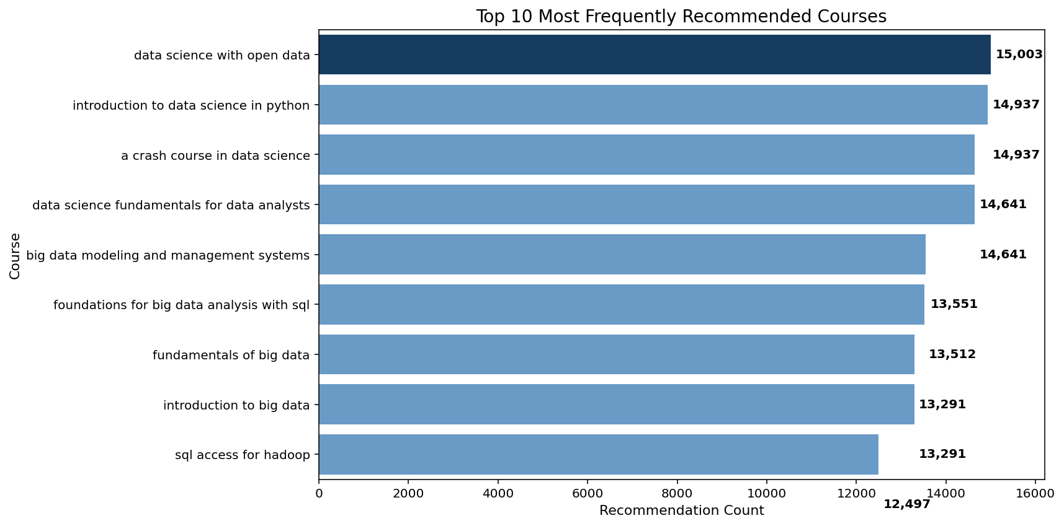
Evaluation results of course similarity based recommender system
Method
Content-Based Filtering
Precomputed Course Similarity Matrix
Bag-of-Words Features
Parameters
Similarity Threshold = 0.60
Total Courses = 307
Similarity Matrix Size = 307 × 307
Recommendation Statistics
Users Evaluated: 29,661
Total Recommendations: 289,738
Average Recommendations/User: 9.77
Average Similarity Score: 0.6872
Key Finding
Each user received approximately 10 personalized course recommendations.
Most recommendations focused on data science, big data, and SQL-related topics.
Notes:
The course similarity recommender used a similarity threshold of 0.60 to identify relevant recommendations.
The model evaluated 29,661 users and generated 289,738 recommendations.
On average, each user received 9.77 new course recommendations.
The most frequently recommended courses focused on data science, big data, and SQL-related topics.
Data Science with Open Data was the most commonly recommended course with 15,003 recommendations.
The average recommendation similarity score was 0.6872, indicating moderate-to-strong content similarity between recommended and enrolled courses.

Slide 15
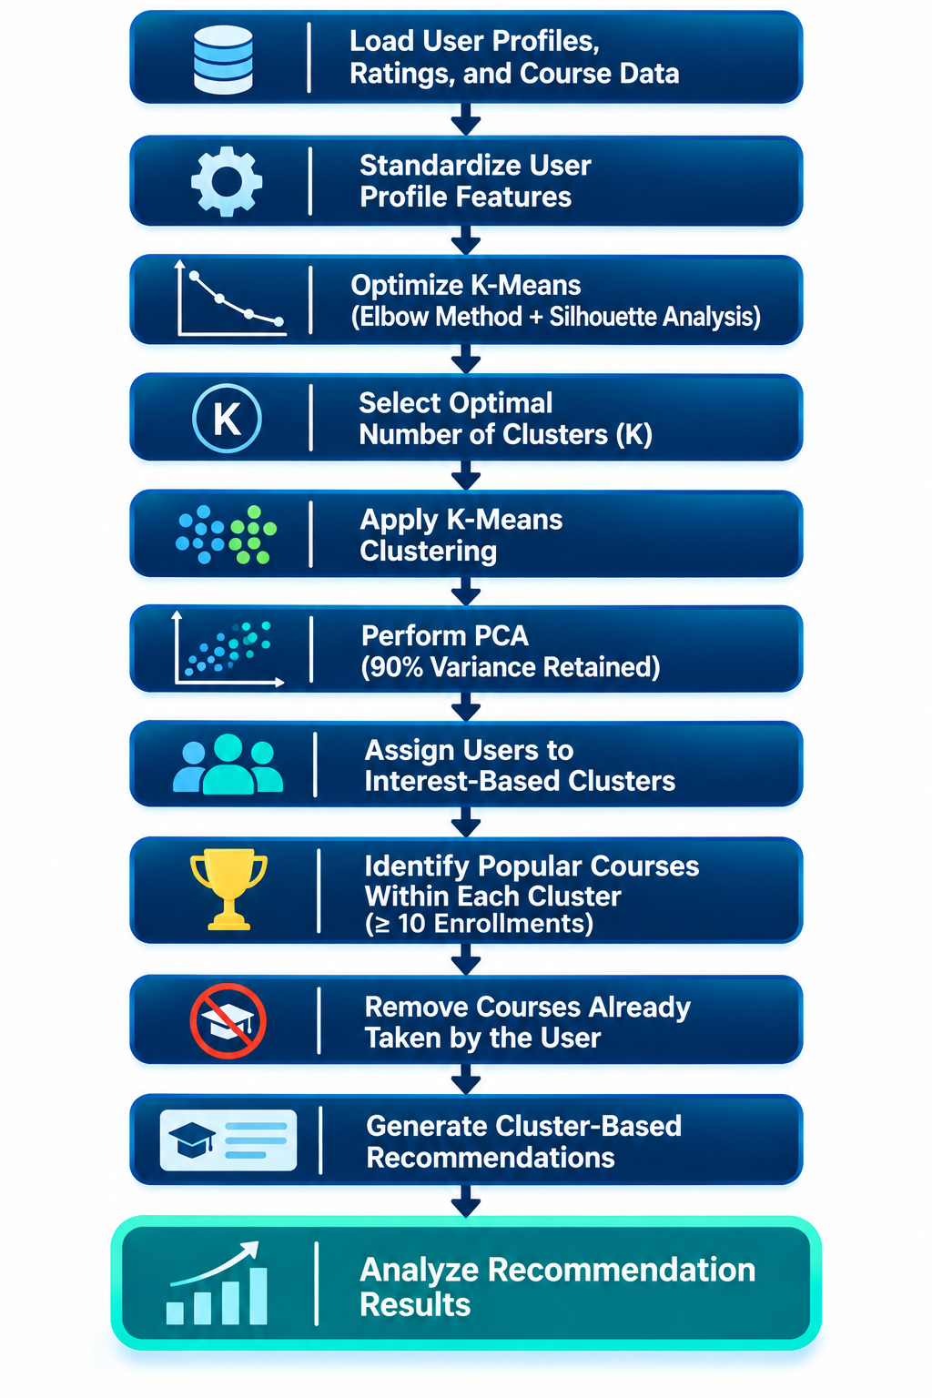
Flowchart of clustering-based recommender system
Method
K-Means Clustering
PCA Dimensionality Reduction
Cluster-Based Recommendations
Key Parameters
Maximum Clusters Tested: 15
PCA Variance Threshold: 90%
Popularity Threshold: 10 Enrollments
Cluster Selection: Silhouette Analysis
Key Insight
Similar learning interests group users, and recommendations are generated from popular courses within each cluster.
Notes:
User profile features were standardized before clustering to ensure equal feature importance.
K-Means clustering was applied and optimized using silhouette analysis to determine the optimal number of user groups.
PCA was used to reduce dimensionality while retaining at least 90% of the original variance.
Users were assigned to clusters representing similar learning interests.
Popular courses within each cluster were identified using a minimum enrollment threshold of 10.
Courses already completed by a user were excluded, and the remaining popular cluster courses were recommended.

Slide 16
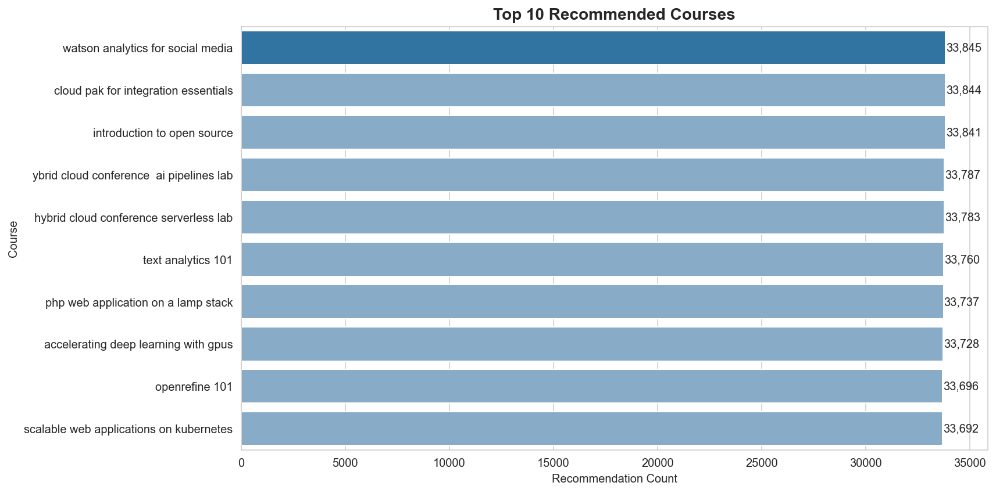
Evaluation results of clustering-based recommender system
K-Means Clustering: Maximum Clusters Tested: 15
Method 1 - Silhouette Analysis
Optimal Number of Clusters (K): 2
Best Silhouette Score: 0.3973
Method 2 - PCA
Variance Retention Threshold: 90%
Selected Components: 9
Variance Retained: 92.73%
PCA Silhouette Score: 0.4101
Recommendation Engine
Popularity Threshold: 10 Enrollments
Recommendation Method: Cluster-Based Filtering
Average New/Unseen Courses Recommended per User
Total Users Evaluated: 33,901
Total Recommendations Generated: 3,389,168
Average Recommendations per User: 99.97
Key Finding:
PCA improved clustering quality, increasing the silhouette score from 0.3973 to 0.4101 while generating approximately 100 unseen course recommendations per user.
Notes:
User profile data was clustered using K-Means after feature standardization.
Silhouette analysis identified 2 as the optimal number of clusters with a silhouette score of 0.3973.
PCA was applied to reduce dimensionality while retaining 92.73% of the original variance.
PCA improved clustering quality, increasing the silhouette score from 0.3973 to 0.4101.
Cluster-based filtering generated 3,389,168 recommendations across 33,901 users.
On average, each user received approximately 100 unseen course recommendations.
These results demonstrate that clustering users by learning interests can generate a large set of personalized course recommendations while improving cluster quality through dimensionality reduction.

Slide 17
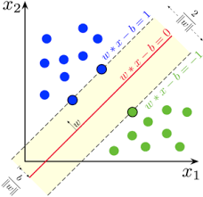
Collaborative-filtering Recommender System using Supervised Learning

Slide 18
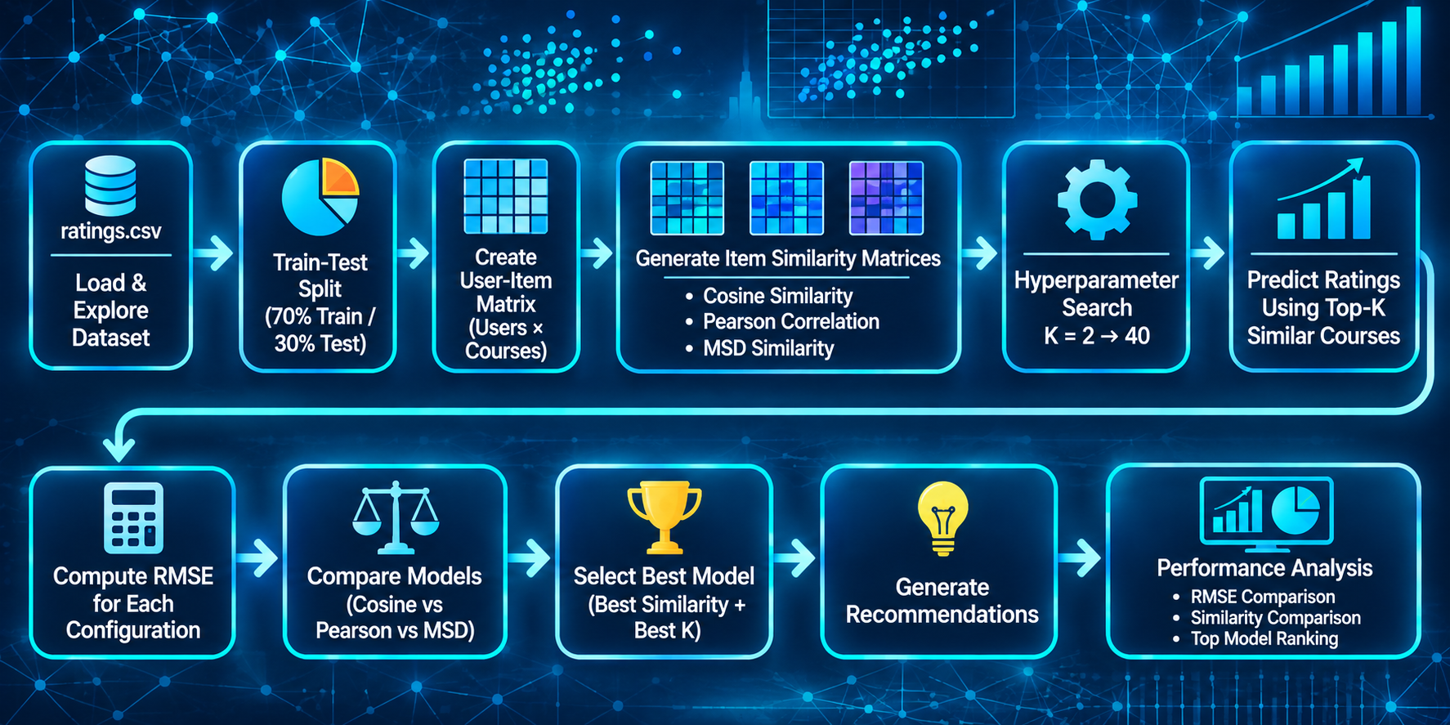
Flowchart of KNN based recommender system
KNN Collaborative Filtering (Item-Based)
Dataset: 233,306 ratings, 33,901 users, 307 courses
Similarity Metrics Tested: Cosine, Pearson, MSD
Neighborhood Sizes Tested: K = 2 to 40
Evaluation Metric: RMSE
Best Configuration: Item-Based KNN, MSD Similarity, K = 35
Recommendation Strategy: Top-K Similar Courses
Best RMSE: 0.8951
Notes:
This KNN-based recommender system uses historical course enrollment and rating data to identify relationships between courses. The dataset was split into training and testing sets, and a user-item matrix was created from the training data.
Three item similarity metrics were evaluated: Cosine Similarity, Pearson Correlation, and Mean Squared Difference (MSD). For each similarity metric, neighborhood sizes ranging from K=2 to K=40 were tested. Course ratings were predicted using the ratings of the most similar courses, and prediction accuracy was evaluated using Root Mean Squared Error (RMSE).
The best-performing configuration was selected based on the lowest RMSE score, with the MSD similarity metric and K=35 providing the strongest performance. The final model was then used to generate personalized course recommendations and analyze recommendation effectiveness.

Slide 19
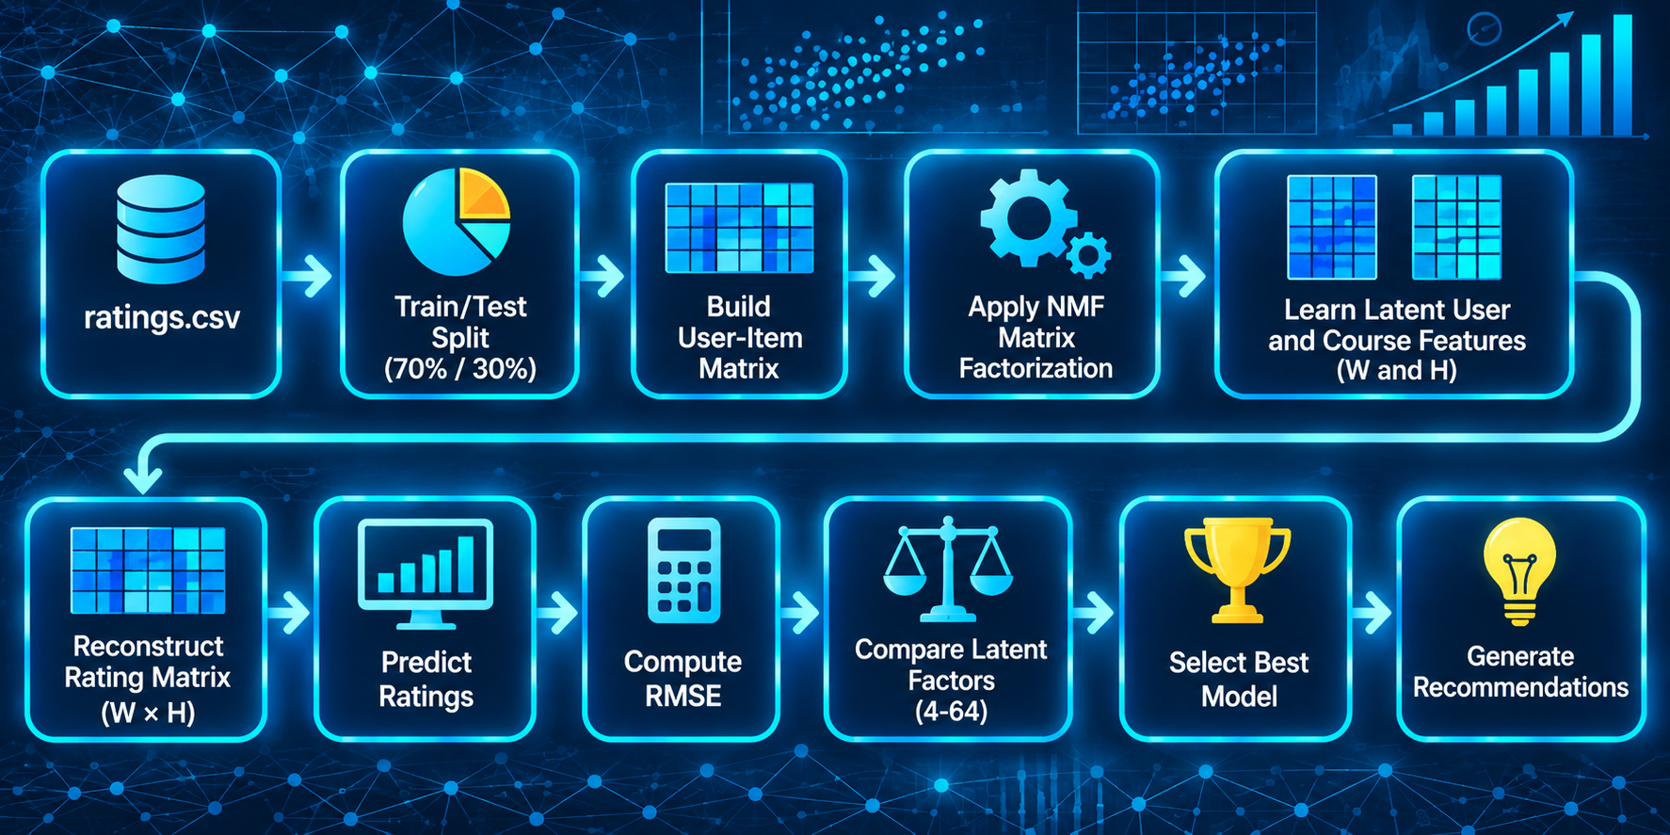
Flowchart of NMF based recommender system
Model Configuration
Recommendation Method: NMF
Latent Factors Tested: 4, 8, 16, 24, 32, 48, 64
Matrix Sparsity: 95.8%
Evaluation Metric: RMSE
Key Results
Best Latent Factors: 4
Best RMSE: 3.2763
Baseline RMSE: 0.8187
Key Finding
NMF struggled with the highly sparse user-item matrix (95.8% sparsity), resulting in substantially higher prediction error than other recommendation approaches.
Notes:
Historical ratings were transformed into a user-item matrix.
NMF decomposed the matrix into latent user and course factors.
Multiple latent factor dimensions were evaluated using RMSE.
The best model used 4 latent factors and achieved an RMSE of 3.2763.
High matrix sparsity (95.8%) limited NMF performance and resulted in higher prediction error than the baseline model.

Slide 20
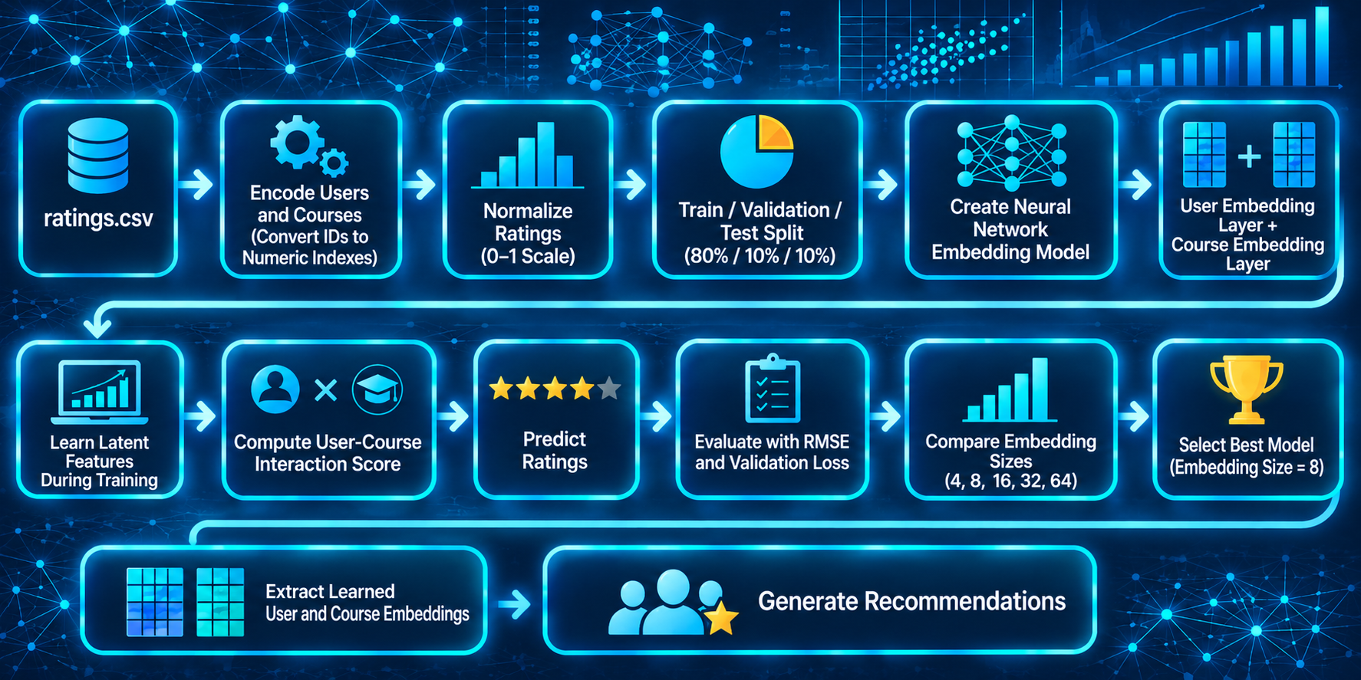
Flowchart of Neural Network Embedding based recommender system
Model Configuration
Embedding Dimensions Tested: 4, 8, 16, 32, 64
Optimizer: Adam
Early Stopping Enabled
Evaluation Metric: RMSE
Best Model Performance
Embedding Size: 8
RMSE: 0.4219
Performance Improvement: 7.96%
Notes:
User and course identifiers were converted into embedding vectors using a neural network architecture.
Multiple embedding dimensions (4, 8, 16, 32, and 64) were evaluated to identify the optimal latent representation size.
The model was trained using the Adam optimizer with early stopping to prevent overfitting.
Recommendation performance was evaluated using RMSE on the test dataset.
The best model used an embedding size of 8 and achieved an RMSE of 0.4219.
This model produced the most accurate rating predictions among all recommendation approaches evaluated.

Slide 21
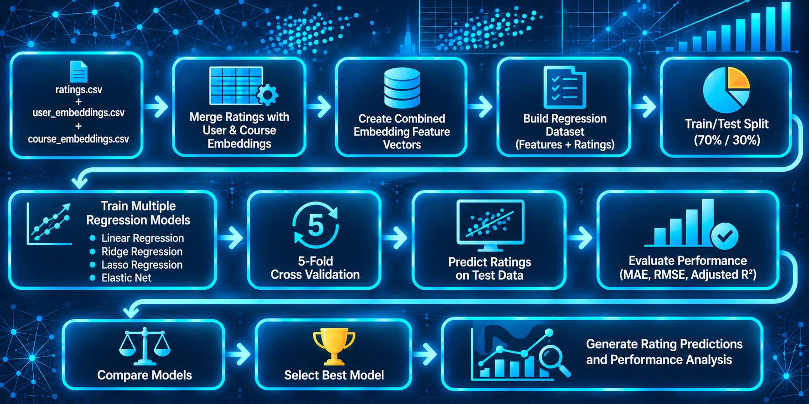
Flowchart of Regression based recommender system
Model Configuration
Input Features: User & Course Embeddings
Validation Method: 5-Fold Cross Validation
Evaluation Metrics: MAE, RMSE, Adjusted R²
Target Variable: Course Rating
Key Insight
Embedding features provided meaningful information for predicting user-course ratings through supervised learning.
Notes:
User and course embeddings generated by the neural network model were combined with historical rating data to create feature representations for each user-course interaction.
These embedding features were used as inputs for multiple regression models to predict course ratings.
Model performance was evaluated using 5-fold cross-validation along with MAE, RMSE, and Adjusted R² metrics.
The best-performing regression model was selected based on prediction accuracy and generalization performance.
Results showed that neural network embeddings captured meaningful user and course characteristics that could be used for supervised rating prediction.
Although regression models improved prediction capability, their performance remained below that of the neural collaborative filtering model.

Slide 22
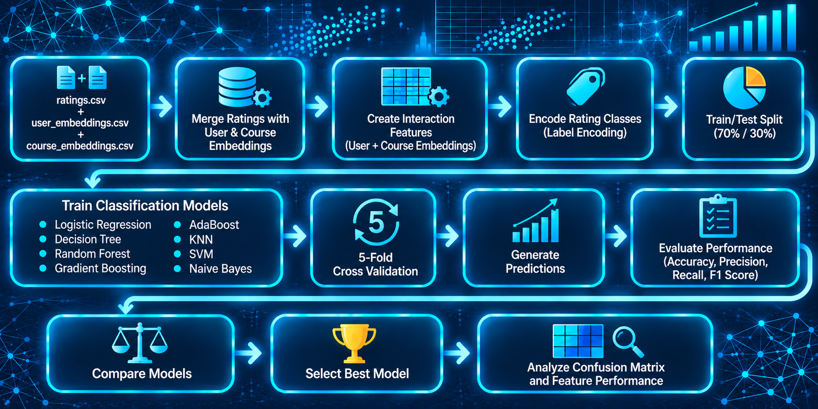
Flowchart of Classification based recommender system
Model Configuration
Input Features: User & Course Embeddings
Target Variable: Encoded Rating Classes
Train/Test Split: 70/30
Validation: 5-Fold Cross Validation
Models Evaluated: 8 Classification Algorithms
Evaluation Metrics
Accuracy
Precision
Recall
F1 Score
Cross-Validation Accuracy
Key Insight
Embedding features successfully supported multiclass rating prediction and model comparison.
Notes:
User and course embeddings generated by the neural network model were combined with historical rating data to create interaction features for classification.
Course ratings were transformed into categorical labels, allowing the recommendation task to be modeled as a multiclass classification problem.
Eight classification algorithms were trained and evaluated using a 70/30 train-test split and 5-fold cross-validation.
Model performance was assessed using Accuracy, Precision, Recall, F1 Score, and Cross-Validation Accuracy.
A confusion matrix was used to visualize prediction results and compare classifier performance.
The results demonstrated that learned embedding features can effectively support supervised classification approaches for course recommendation and rating prediction.

Slide 23
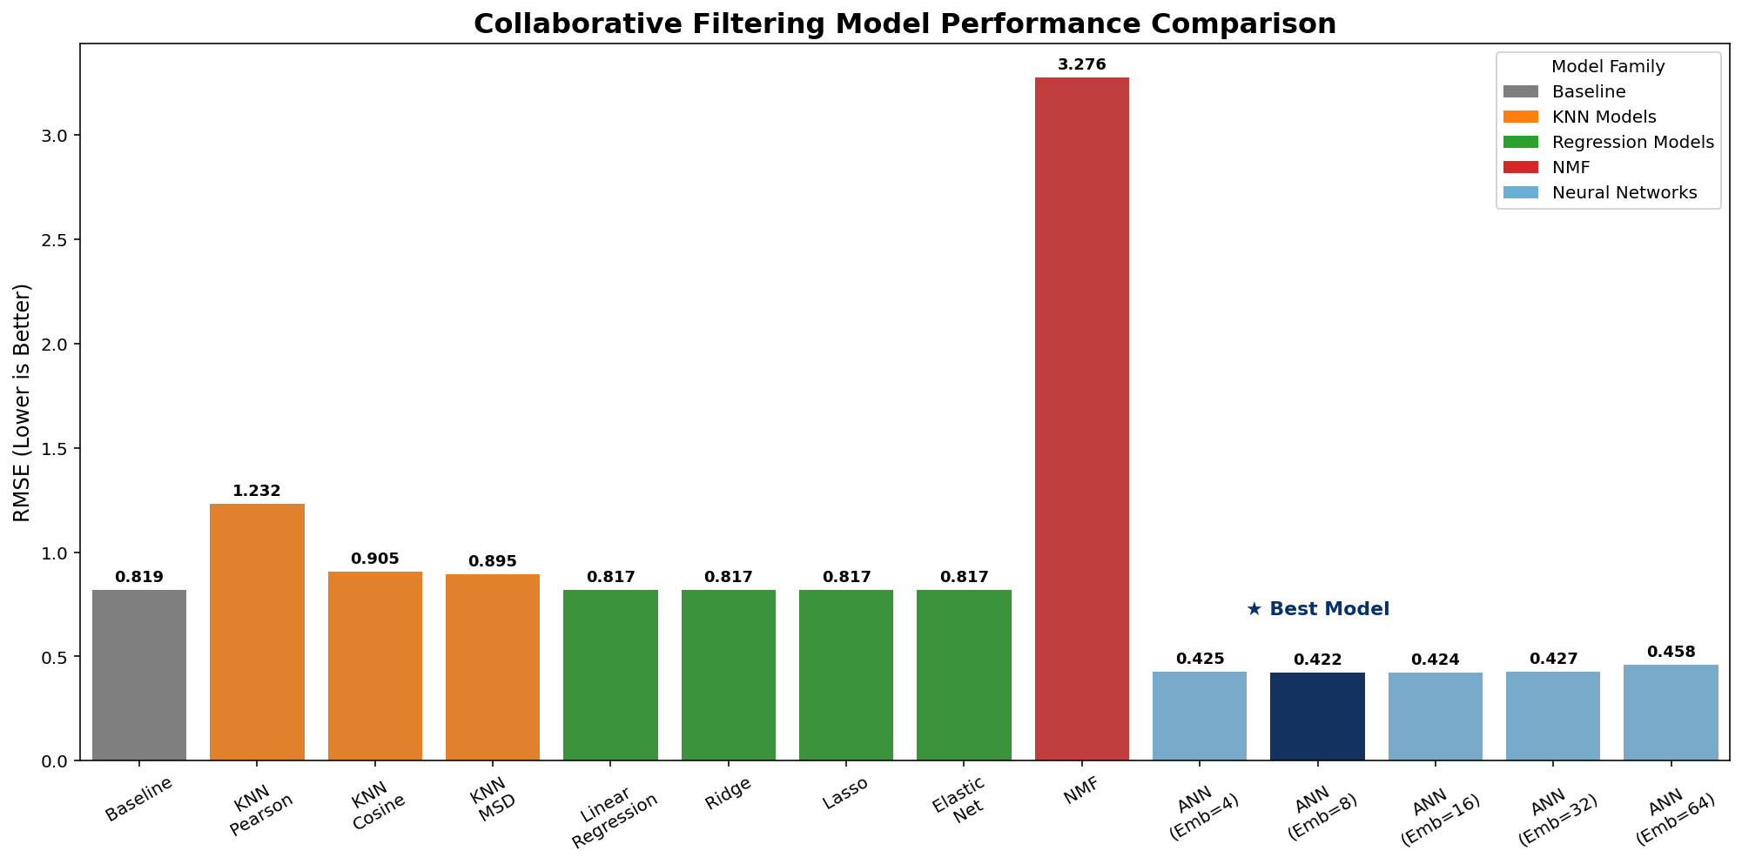
Compare the performance of collaborative-filtering models
Key Insights
RMSE was used to compare recommendation model performance, where lower values indicate better prediction accuracy.
The Neural Network model (Embedding Size = 8) achieved the lowest RMSE (0.4219) and was the best-performing recommendation approach.
Item-Based KNN with MSD similarity achieved the strongest performance among traditional collaborative filtering methods (RMSE = 0.8951).
Embedding-based regression models performed similarly to the baseline predictor (RMSE ≈ 0.82).
NMF produced the highest RMSE (3.2763), demonstrating sensitivity to the highly sparse user-item matrix.
Overall, neural collaborative filtering delivered the most accurate rating predictions.
Notes:
RMSE was used as the primary evaluation metric to compare recommendation model performance, where lower RMSE values indicate more accurate rating predictions.
Multiple collaborative-filtering approaches were evaluated, including KNN, NMF, neural collaborative filtering, and embedding-based regression models.
Neural Collaborative Filtering achieved the best overall performance with an RMSE of 0.4219, demonstrating the strongest ability to learn latent user and course preferences.
Item-Based KNN using MSD similarity was the best-performing traditional collaborative-filtering method, achieving an RMSE of 0.8951.
Embedding-based regression models performed similarly to the baseline predictor, while NMF produced the highest prediction error due to the highly sparse user-item matrix.
Overall, neural network embeddings provided the most accurate recommendation predictions and emerged as the strongest recommendation approach evaluated in this project.

Slide 24
Conclusions
Conclusions
Multiple recommendation approaches were developed and evaluated, including content-based filtering, clustering, collaborative filtering, matrix factorization, and neural network models.
Content-based recommenders successfully generated personalized recommendations using learner interests, course genres, and course similarity.
K-Means clustering identified two distinct learner groups, and PCA further improved clustering quality by increasing the silhouette score from 0.3973 to 0.4101.
Among traditional collaborative filtering methods, Item-Based KNN using MSD similarity (K=35) achieved the best performance with an RMSE of 0.8951.
Neural Collaborative Filtering achieved the strongest overall performance with an RMSE of 0.4219, outperforming all other recommendation approaches.
NMF struggled with the highly sparse user-item matrix (95.8% sparsity) and produced the weakest prediction performance.
Final Takeaway
Neural Collaborative Filtering using learned user and course embeddings provided the most accurate and effective personalized course recommendations in this project.
Notes:
Several recommendation techniques were evaluated to identify the most effective approach for personalized course recommendation.
Content-based methods leveraged course features and learner interests to generate relevant recommendations.
Clustering methods successfully grouped users with similar learning preferences and generated large numbers of unseen course recommendations.
Traditional collaborative filtering performed well, with Item-Based KNN outperforming other neighborhood-based approaches.
Neural Collaborative Filtering achieved the lowest prediction error and learned meaningful latent user and course representations through embeddings.
Overall, neural network embeddings proved to be the most effective recommendation strategy for this dataset and project objectives.

Slide 25
Appendix
Project Resources
GitHub Repository
Key Deliverables
Exploratory Data Analysis Notebooks
Content-Based Recommender Systems
Clustering-Based Recommender System
KNN Collaborative Filtering
Non-Negative Matrix Factorization (NMF)
Neural Collaborative Filtering
Embedding-Based Regression Models
Classification Models
IBM ML Capstone Source Code
Repository link
https://github.com/niecestroa/pro-ibm-ml-course-projects/tree/main/capstone
https://github.com/niecestroa/pro-ibm-ml-course-projects/tree/main/capstone/source
Supporting Outputs
Recommendation Model Comparison Chart
KNN, NMF, and ANN Evaluation Results
Clustering Analysis and PCA Results
Recommendation Statistics and Visualizations
Technologies Used
Python
Pandas
NumPy
Scikit-Learn
TensorFlow / Keras
Matplotlib
Seaborn
Notes:
The appendix contains supporting materials developed throughout the project.
Multiple machine learning and recommendation approaches were implemented and evaluated.
Source code, model outputs, evaluation metrics, and visualizations are available to support the findings presented in this report.
The project utilized both traditional machine learning methods and deep learning techniques to develop and evaluate personalized course recommendation systems.

